Slide 1
Impact of varying collision avoidance strategies on human stress level in human-robot interaction.
13.11.2023
Mohammed Faizan
Supervisors : M.sc. Heiko Renz , M.sc. Khazar Dargahi Nobari
Univ.-Prof. Dr.-Ing. Prof. h.c. Dr. h.c. Torsten Bertram
Institute of Control Theory and Systems Engineering

Slide 2
Progress and Things to do
Task development and implementation almost ready- Still need to define a proper protocol for the experiments and get final things tested and ready( Should be done by this week and ready for demo and start experiments next week)
Finalize the questionnaires and digitalize it(Jotforms or GoogleForms)

Slide 3
Sample Questionnaire
The State-Trait Anxiety Inventory (STAI) Vs NASA Task Load Index Vs Self-Assessment Manikin (SAM)
STAI ( 2 Times- Before and After all Experiments)
Differentiates between the temporary condition of "state anxiety" and the more general and long-standing quality of "trait anxiety."
Fairly Long 20 Questions
Not specific for task-related stress since it measures general anxiety, which is not always directly caused by tasks or workload.
NASA ( 3- Times – After each Collision Avoidance Task?)
It measures workload rather than stress or anxiety per se, but can useful for comparing the stress load between the different scenarios.
SAM(After Each Sub-task 3 Variations of WorkSpaces and 3 variation Collision Avoidance)
Pictorial representation and also shows a participant's emotional response in pleasure, arousal, and dominance, which can be particularly useful for measuring immediate reactions to a stimulus.

Slide 5
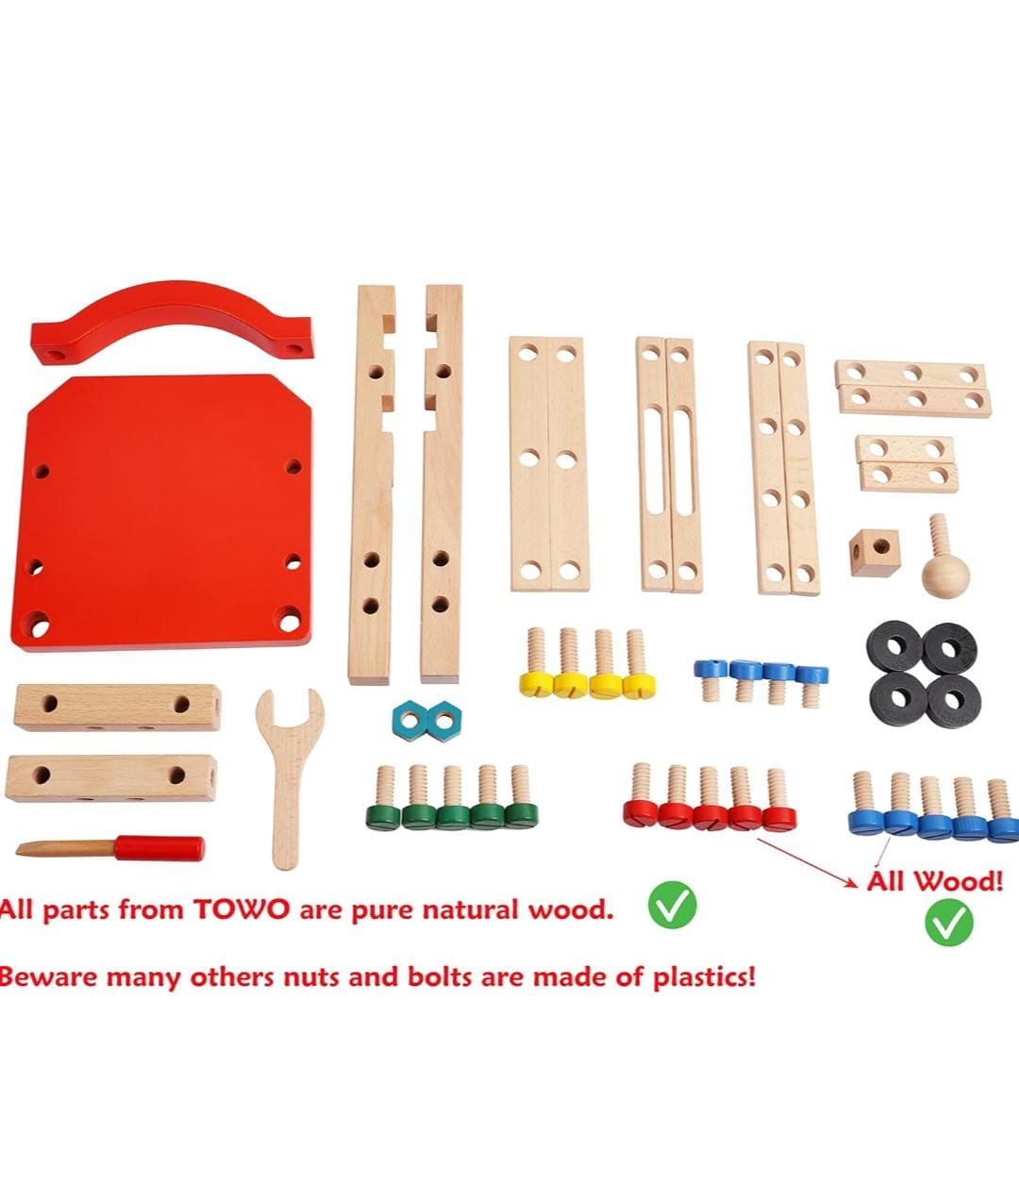
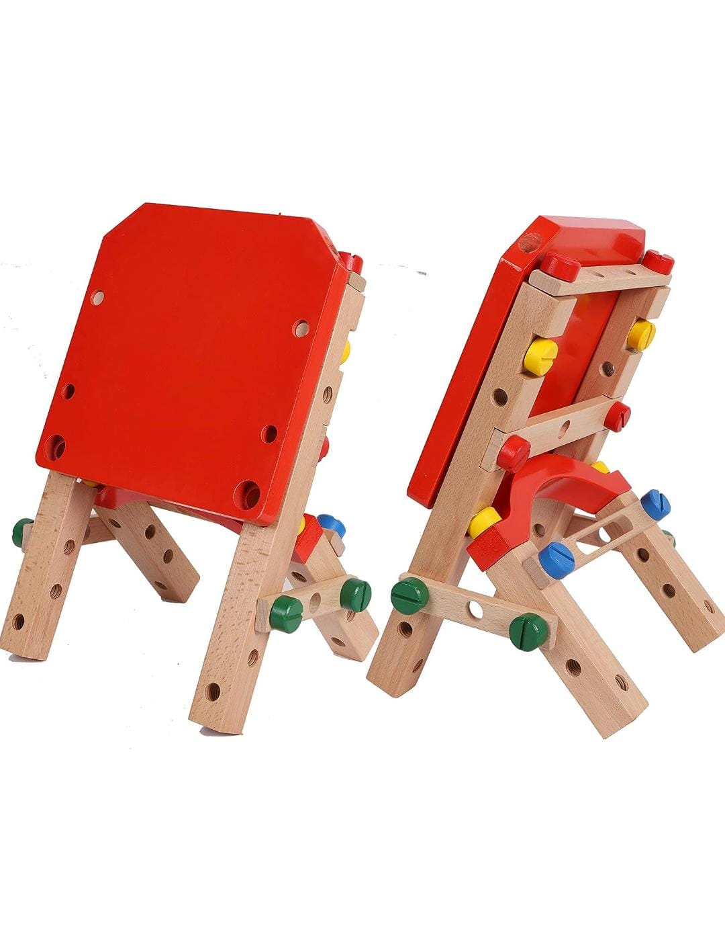
Sample Assembly Task

Slide 6
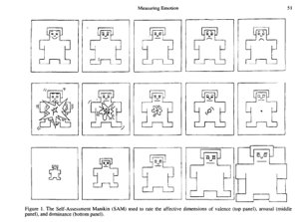
A Self-Assessment Manikin (SAM)to gather their affective state in the different task configurations by evaluating on a 9-point scale three dimensions: valence, arousal, and dominance.
Valence represents the pleasantness relative to a stimulus (for instance, happiness and relaxation are associated with a high valence, while anxiety or anger with a low valence).
Arousal refers to the intensity of emotion provoked by a stimulus (e.g., fear and anger are usually associated with a high arousal, while relaxation and boredom with a low arousal).
Dominance represents the degree of control felt relative to a stimulus (e.g., relaxation or anger are usually associated with a high dominance, while fear or anxiety with low dominance).

Slide 7
Designing of Experiments
Three types of controllers: default, static collision avoidance, and predictive collision avoidance.
Take different workspace into consideration, same workspace but no direct contact as trail and getting to know the experiment and then move on to actual collabrotive tasks?
Example experiment- Moving blocks and placing of bolt and human screwing
- Sorting of objects into bins. Robot picks object and gives it operator
What more can our robots do, how do I define the task?
Collection of subject data- Surveys etc to be made
Consent Forms/Anything else to be made to get ready for the experiments?

Slide 8
References
A. de Santos Sierra, C. S. Avila, J. G. Casanova, and G. B. del Pozo, ‘‘A stress-detection system based on physiological signals and fuzzy logic,’’ IEEE Trans. Ind. Electron., vol. 58, no. 10, pp. 4857–4865, Oct. 2011.
M. V. Villarejo, B. G. Zapirain, and A. M. Zorrilla, ‘‘A stress sensor based on galvanic skin response (GSR) controlled by ZigBee,’’ Sensors, vol. 12, no. 5, pp. 6075–6101, May 2012, doi: 10.3390/s120506075.
A. Sano and R. W. Picard, ‘‘Stress recognition using wearable sensors and mobile phones,’’ in Proc. Humaine Assoc. Conf. Affect. Comput. Intell. Interact., Sep. 2013, pp. 671–676.
Y. S. Can, N. Chalabianloo, D. Ekiz, J. Fernandez-Alvarez, G. Riva, and C. Ersoy, ‘‘Personal stress-level clustering and decision-level smoothing to enhance the performance of ambulatory stress detection with smartwatches,’’ IEEE Access, vol. 8, pp. 38146–38163, 2020
A. G. Airij, R. Sudirman, and U. U. Sheikh, ‘‘GSM and GPS based realtime remote physiological signals monitoring and stress levels classification,’’ in Proc. 2nd Int. Conf. BioSignal Anal., Process. Syst. (ICBAPS), Kuching, Malaysia, Jul. 2018, pp. 130–135.
] M. Gjoreski, M. Luštrek, M. Gams, and H. Gjoreski, ‘‘Monitoring stress with a wrist device using context,’’ J. Biomed. Informat., vol. 73, pp. 159–170, Sep. 2017
Y. S. Can, N. Chalabianloo, D. Ekiz, and C. Ersoy, ‘‘Continuous stress detection using wearable sensors in real life: Algorithmic programming contest case study,’’ Sensors, vol. 19, no. 8, p. 1849, Apr. 2019
M. Zubair and C. Yoon, ‘‘Multilevel mental stress detection using ultrashort pulse rate variability series,’’ Biomed. Signal Process. Control, vol. 57, Mar. 2020, Art. no. 101736.
Giakoumis, D.; Drosou, A.; Cipresso, P.; Tzovaras, D.; Hassapis, G.; Gaggioli, A.; Riva, G. Using activity-related behavioural features towards more effective automatic stress detection. PloS one 2012, 7, e43571.
Arnrich, B.; Setz, C.; La Marca, R.; Tröster, G.; Ehlert, U. What does your chair know about your stress level? IEEE Transactions on Information Technology in Biomedicine 2009, 14, 207–214
Elgendi, M. On the analysis of fingertip photoplethysmogram signals. Current cardiology reviews 2012, 8, 14–25
Garcia-Ceja, E.; Osmani, V.; Mayora, O. Automatic stress detection in working environments from smartphones’ accelerometer data: a first step. IEEE journal of biomedical and health informatics 2015, 20, 1053–1060.
Sano, A.; Picard, R.W. Stress recognition using wearable sensors and mobile phones. In Proceedings of the 2013 Humaine Association Conference on Affective Computing and Intelligent Interaction. IEEE, 2013, pp. 671–676
Giakoumis, D.; Drosou, A.; Cipresso, P.; Tzovaras, D.; Hassapis, G.; Gaggioli, A.; Riva, G. Using activity-related behavioural features towards more effective automatic stress detection. PloS one 2012, 7, e43571.

Slide 9
Overveiw of Stress detection studies using PPG and Motion
Paper | Signals Used | Technique | Result
[1] | GSR, HR | Fuzzy Decision Algorithm was used for manual and automatic implementation of the proposed approach. | 90% Accuracy
[2] | GSR | WEKA learning machine was used for testing Bayesian Network (BN), J48, and Sequential Minimal Optimization (SMO). | Detected different states of each user with a success rate of 76.56%.
[3] | ACC and skin conductance | evaluated performance using the following six classifiers -SVM with linear kernel -SVM with Radial basis function (RBF) -KNN (k=1-4) -PCA and SVM with linear kernel -PCA and SVM with Radial basis function (RBF) -PCA and KNN (k=1-4) | This system gives over 75% accuracy of low and high perceived stress recognition using the sensor data.
[4] | HR, Skin Conduct ance, ACC, ST | The WEKA Toolkit was used for classification algorithms. 2. PCA & SVM with a linear Kernel, RF (with 100 trees), KNN (n=1), PCA & Linear Discriminant analysis (LDA), and MultiLayer Perceptron (MLP) were used for classification. | 1. The maximum classification accuracy was 94.52% and minimum accuracy was 91% for 3 classes. 2. They developed a session-based stress classifier that gives a maximum of 94.44% accuracy with HR and 100% with EDA signals.
[5] | HR, Skin conducta nce, ST | A rule-based fuzzy logic algorithm was proposed and used for stress level classification. Also, decision tree, KNN, and Naïve Bayes algorithm were used for comparison of accuracy. | The overall accuracy achieved by the system was 96.19% by using a proposed fuzzy logic algorithm.
[6] | HR, EDA, BVP, ST, ACC | A variety of machine learning algorithms were experimented on the dataset using LOSO evaluation which is – majority classifier, J48, Naïve Bayes, KNN, SVM, Bagging, Boosting, RF, Ensemble selection | This method detected 70% of the stress events with a precision of 95%.

Slide 10
Overveiw of Stress detection studies using PPG and Motion
Paper | Signals Used | Technique | Result
[7] | GSR, ACC,BVP;ST | 1. Fast Fourier Transform (FFT) and Lomb-Scargle periodogram were applied for feature extraction. 2. PCA & LDA, PCA & SVM with the radial kernel, KNN (n=1), Logistic Regression, RF (with 100 trees), and multilevel perceptron were used as a classifier with 10-fold crossvalidation. | 1. For 3 class stress level detection, 90.40% accuracy was obtained by using Empatic E4 device . 2. Achieved maximum 97.92% accuracy with their person-specific models while 88.20% for general models. 3. RF and Multilayer Perceptron performed best among all classifiers.
[8] | GSR, ACC,BVP;ST | 1. Quadratic discriminant analysis and SVM were used as classifiers and LOSO (leave-one-subject-out) used for evaluation of classification performance. 2. To capture the stressrelated temporal information, a set of new Poincare plot features was used. | SVM gives 94.33% accuracy for the detection of fivelevel stress.
[9] | GSR,ECG,ACC,Body Posture | Behavioral body language features used in the study are visual cues that are extracted from the data acquired by Kinect and an HD camera. Classification is performed using linear discriminant analysis | Maximum classification accuracy of 96.30% is achieved.
[10] | Posture Data | A rule-based fuzzy logic algorithm was proposed and used for stress level classification. Also, decision tree, KNN, and Naïve Bayes algorithm were used for comparison of accuracy. | The overall accuracy achieved by the system was 96.19% by using a proposed fuzzy logic algorithm.

Slide 11
Pre-Processing
EDA through a low-pass filter to remove high frequency noise
EDA segmentation into a slow-varying baseline conductivity known as skin conductance level (SCL) and a high-frequency component called skin conductance response (SCR)

Slide 12
Possible Feature Extraction
ACC-Features for accelerometer sensors in stress recognition studies include mean, standard deviation, variance, maximum, absolute value, signal magnitude area, root mean squared, energy, differential entropy, discrete Fourier transform, peak magnitude frequency, peak power, and zero crossing [7,12,13]
GSR(EDA)-statistical features of mean, standard deviation, mean of the absolute values, root mean square, the proportion of negative samples, the slope of the EDA level, mean EDA peak rate, and height, minimum and maximum have been commonly used [14, 15].
BVP-HR,HRV,the Inter-Beat-Interval (IBI).
For Motion?

Slide 13
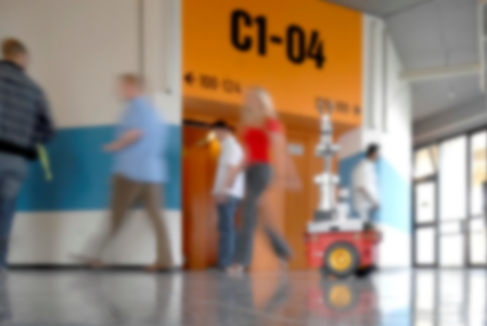
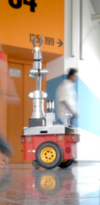

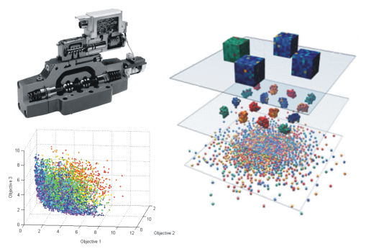
Thank you for your kind attention!

Slide 14
E4 Topics
1.biosensors/empatica_e4/bvp :
type: standard_msg/Float32
size: 1-by-1
detail:the Blood Volume Pulse (BVP) signal( Value is derived from the light absorbance of the arterial blood).
Average Freq: 60
2.biosensors/empatica_e4/gsr :
type: standard_msg/Float32
size: 1-by-1
detail: Galvanic Skin Response (GSR) signal.
Average Freq:4
3. biosensors/empatica_e4/hr :
Type: standard_msg/Float32
size: 1-by-1
detail: the Heart Rate (HR) signal. Freq:1.1
4. biosensors/empatica_e4/st :
Type: standard_msg/Float32
size: 1-by-1
detail: Skin Temperature (ST) signal
Freq: 0.6
5. biosensors/empatica_e4/ibi :
type: standard_msg/Float32
size: 1-by-1
detail: the Inter-Beat-Interval (IBI) signal. ( value is the distance from the previous detected heartbeat in seconds.)
Freq: 1.2
6. biosensors/empatica_e4/acc :
type: standard_msg/Float32MultiArray
size: 1-by-1
detail: the accelerometer (ACC) data.
Average Freq: 31
7. biosensors/empatica_e4/bat :
type: standard_msg/Float32
size: 1-by-1
detail: the Battery Level (BAT) signal.

Slide 15
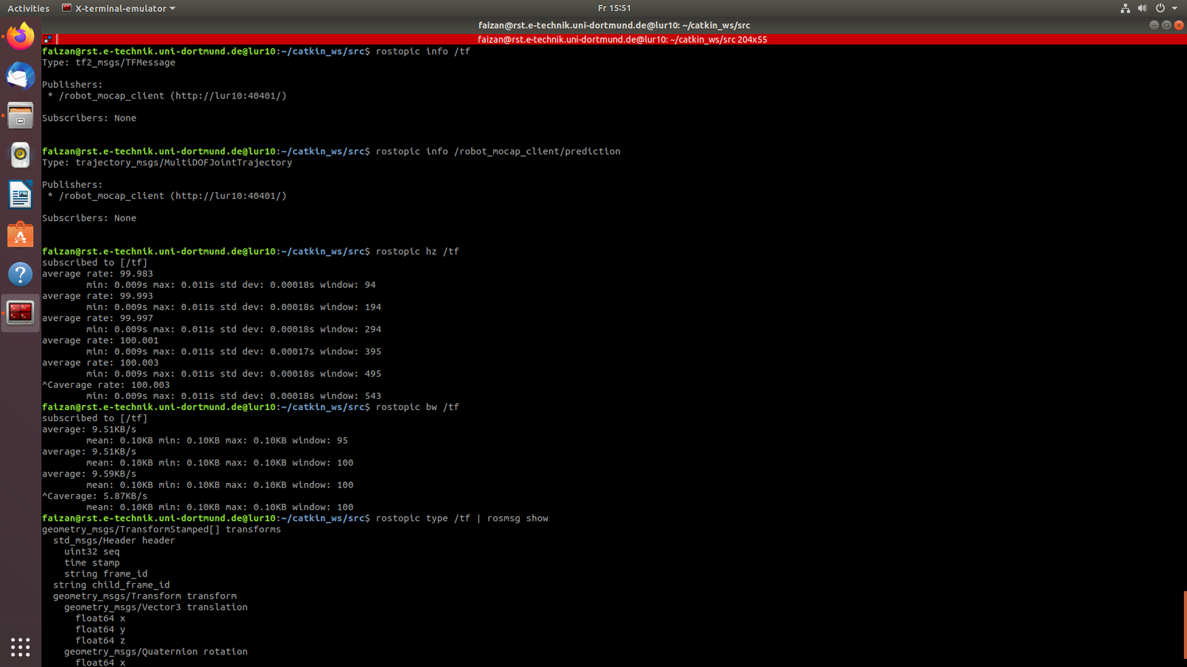
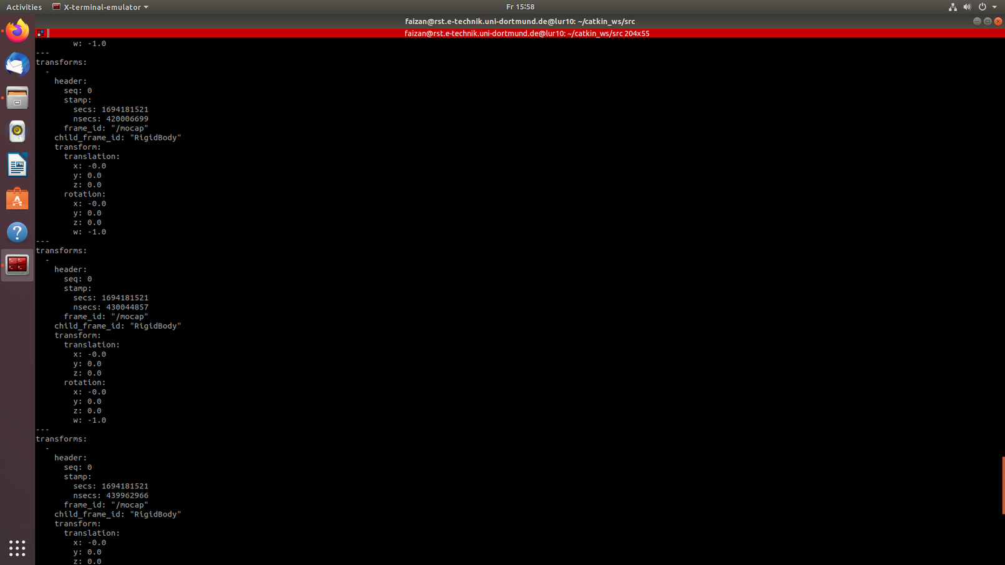
MoCap Topic

Slide 16
Gliederung
Einleitung
Inaktive Ebene
Aktive Ebene (RGB: 132/184/24)
VERWENDE “Layouts” für die Bearbeitung
Zusammenfassung

Slide 17
Outline
Introduction
Inactive Layer
Active Layer (RGB: 132/184/24)
USE “Layouts” for modifications
Conclusions

Slide 18
erste Ebene: schwarz, normal, Arial, 22 hervorzuhebende Ausdrücke: apfelgrün und fett (RGB: 132 184 24) oder orange und fett (RGB: 255 102 0)
zweite Ebene: schwarz, normal, Arial, 20; apfelgrün orange
dritte Ebene: grau, normal, Arial, 18; apfelgrün orange

Slide 19
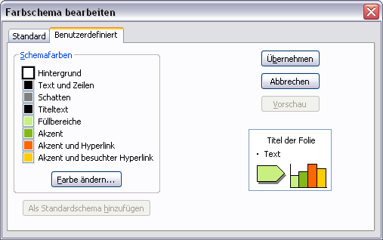
Farbschema
Weitere Farben zum Hervor- heben und Farbighinterlegen (Transparenz = 0%, da sonst teilweise karierte Darstellung möglich)
Farbschema
RGB | Rand | Füllung
 | 132 184 24 | 202 239 129
 | 255 102 0 | 255 173 117
 | 0 102 255 | 139 186 255
 | 255 204 0 | 255 233 139

Slide 20
TeX Formeln
Formeln im Latex-Stil lassen sich bequem mit Hilfe des IguanaTex Plugins in die Folien einbinden (Windows): http://www.jonathanleroux.org/software/iguanatex/
Nachhaltige, wiederwertbare Foliensätze am Lehrstuhl RST sollten grundsätzlich nur mit Boardmitteln + IguanaTex erstellt werden.
Für Mac OSX Benutzer gibt es eine Alternative, Kompatibilität mit IguanaTex ist ausgeschlossen und daher sollte diese nur in wenigen Fällen Verwendung finden (z.B. in Abschlussarbeiten): http://www.chachatelier.fr/latexit/

Slide 21
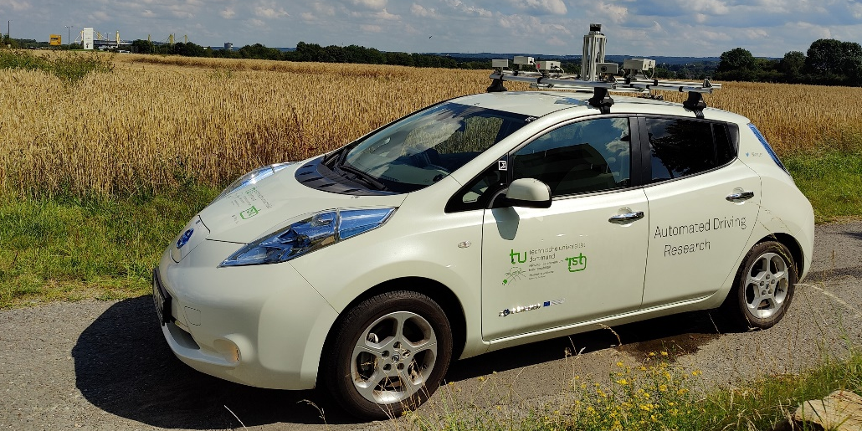
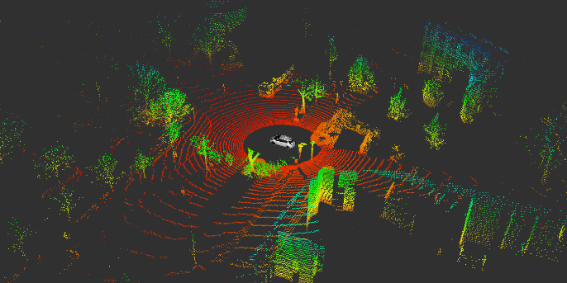
Thank you for your kind attention!
Univ.-Prof. Dr.-Ing. Prof. h.c. Dr. h.c. Torsten Bertram
Institute of Control Theory and Systems Engineering

Slide 22
Vielen Dank für Ihre Aufmerksamkeit!
Univ.-Prof. Dr.-Ing. Prof. h.c. Dr. h.c. Torsten Bertram
Lehrstuhl für Regelungssystemtechnik

Slide 23
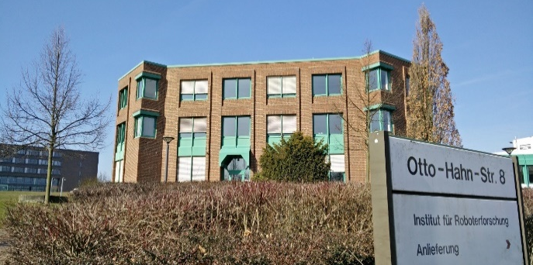
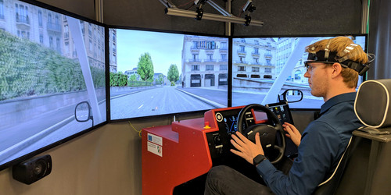
Vielen Dank für Ihre Aufmerksamkeit!
Univ.-Prof. Dr.-Ing. Prof. h.c. Dr. h.c. Torsten Bertram
Lehrstuhl für Regelungssystemtechnik

Slide 24
Thank you for your kind attention!
Univ.-Prof. Dr.-Ing. Prof. h.c. Dr. h.c. Torsten Bertram
Institute of Control Theory and Systems Engineering

Slide 25
Vielen Dank für Ihre Aufmerksamkeit!
Univ.-Prof. Dr.-Ing. Prof. h.c. Dr. h.c. Torsten Bertram
Lehrstuhl für Regelungssystemtechnik

